Slide 1
PRAGATI LAB INFORMATION SYSTEM
~BY
B.SATYA(TEAM LEAD)
M.HEMANTH
K.SURESHMA
K.HARSHITHA

Slide 2
ABSTRACT
The Pragati Lab Information System is a simple C++-based console application designed to provide quick access to laboratory details in an academic environment. The system allows users to input a floor and room number to retrieve information such as the number of systems, fans, lights, chairs, projectors, and air conditioners available in a lab. This reduces dependency on manual inquiries and improves efficiency in accessing lab-related data.

Slide 3
Introduction
In many institutions, students and staff often need information about laboratories such as infrastructure and availability. Traditionally, this requires asking lab assistants or checking manually, which is time-consuming.
This project aims to solve this problem by:
Providing instant lab details
Reducing manual effort
Improving accessibility of lab data
The system is implemented using C++, making it lightweight and easy to run on any system.

Slide 4
Flowchart (Text Representation)
START
↓
Input Floor
↓
Input Room Number
↓
Check Floor & Room Match?
↓ ↓
YES NO
↓ ↓
Display Show Error
Details Message
↓
END

Slide 5
ALGORITHM
Step1: Start the program.
Step2: Declare variables for floor and room.
Step3: Take input from the user (floor and room).
Step4: Call the function displayLab().
Inside the function:
Step5: Check floor and room using if-else conditions.
Step6: If matched → display lab details.
Step7: Else → display “Invalid Floor or Room”.
Step8: End program.

Slide 6
Methodology
The project follows a simple procedural approach:
The user provides input through the console
The system processes input using conditional statements (if-else)
Based on matching conditions, relevant lab data is displayed
If no match is found, an error message is shown
This approach ensures:
Simplicity
Fast execution
Easy modification and scalability

Slide 7
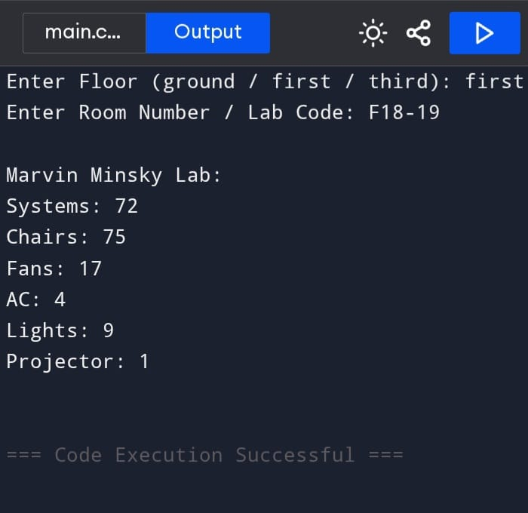
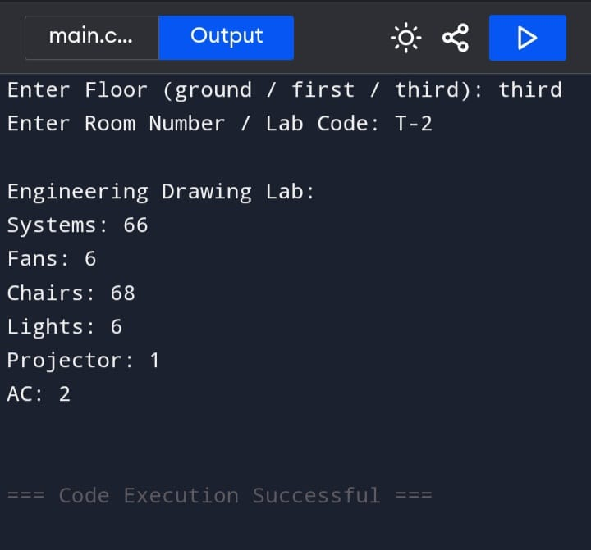
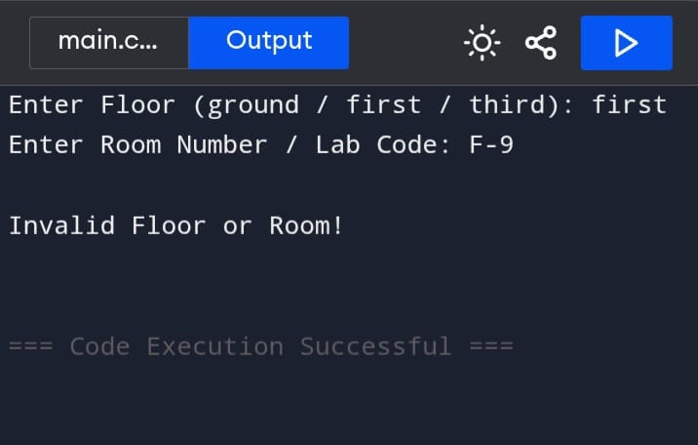
RESULTS

Slide 8
Conclusion
The Pragati Lab Information System successfully provides an efficient way to access lab details. It simplifies the process of retrieving information and minimizes manual effort. The project demonstrates the practical use of C++ in solving real-world problems in an academic environment.

Slide 9
Future Work
This project can be improved by:
Adding a Graphical User Interface (GUI)
Storing data in a database
Developing a web or mobile application
Adding search and filter options
Including real-time lab availability status

